Slide 1





Towards An Automated Freight Industry: Using “MLOps” to Productionize Data Science and Increase the Efficiency of Kansas City’s Startup Companies
z
Presentation by:
Kevin McPherson
Capstone Project Presentation
Flatiron School - Data Science Online Cohort
July 23, 2020

Slide 2

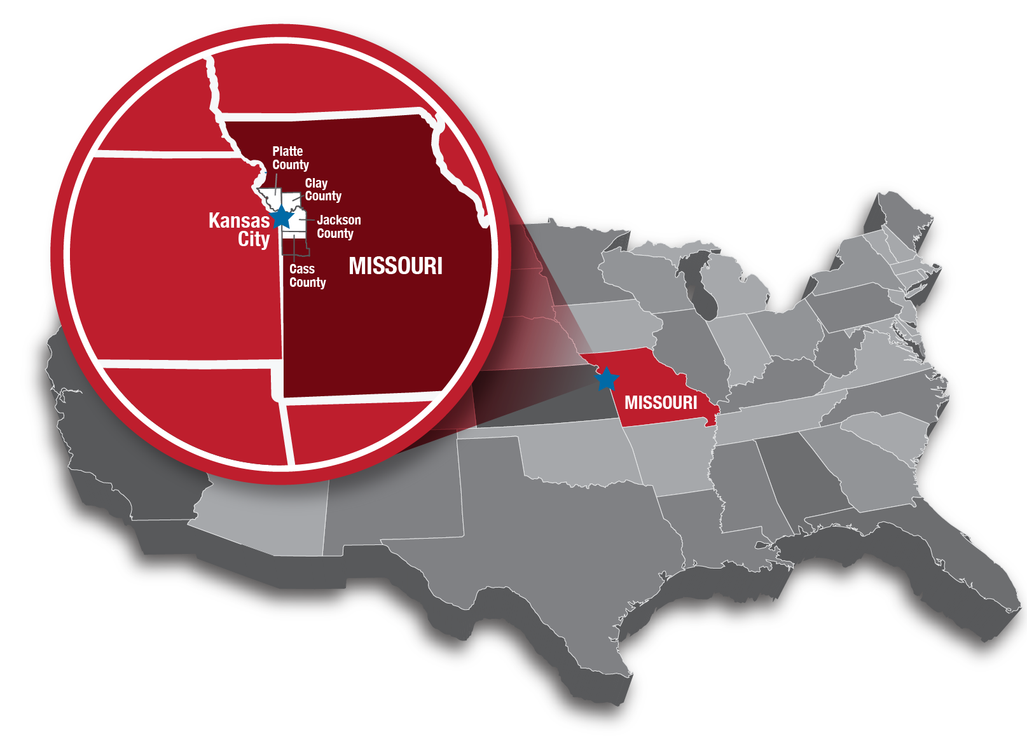
An Outline for Today’s Presentation: What is the Freight Industry?
Kansas City is the heart of the freight industry.
SuperDispatch is a premier vehicle shipping company
Bellwethr is an up and coming machine learning company

Slide 3
Scoping the Freight Industry’s Logistical Inefficiencies through the Kansas City Lens
Central Dispatch
Shipper
Carrier
The current solution to pricing is:
Requiring too many moving parts
Requiring too much coordination across geographies
Is too costly, both on a human capital side and a business-tethering side
Proposal: Automate the prediction via an easy-to-access API

Slide 4
Our Data Science Methodology: Using Multiply Linear Regression and Ensemble Methods
”Linear” meaning line and “regression” meaning returning to, we model the data on multiple factors as inputs to construct a line
“Ensemble” meaning a collection of methods strung together
Analyze and compare results. Deploy most accurate result to API

Slide 5
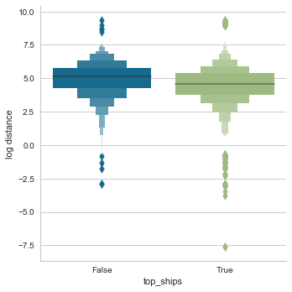
Our Data Science Methodology (Cont.): Getting Market Insights from Vehicle Type
The non-top-shipping groups contained all other vehicles.
The top-shipping groups contained 'sedan', 'suv', ‘4-door pickup', 'other', 'van'
* Found statistical significance between the groups’ difference: less than 1x10^-89% by chance alone

Slide 6
Our Data Science Methodology (Cont.): Understanding Test Metrics
Does the data fit the model? The error metrics show how far away from the line the predictions are.
Does reproduction of the model help predict future prices? We found that the models chosen are probably over-generalizing the data

Slide 7
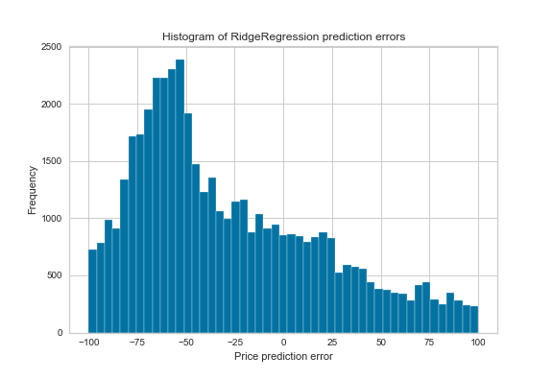
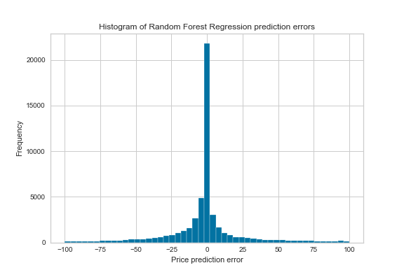

Our Data Science Methodology (Cont.): A Refinement to Ensemble Methods
In order to iterate, we must check multiple error metrics
One of those, if we use a regression model is mean absolute error
A curve centered around 0 is desirable
Ensemble Method Error Distribution
Linear Regression Error
MAE: ~31.09; RMSE: ~107.01
Ridge Regression Error

Slide 8
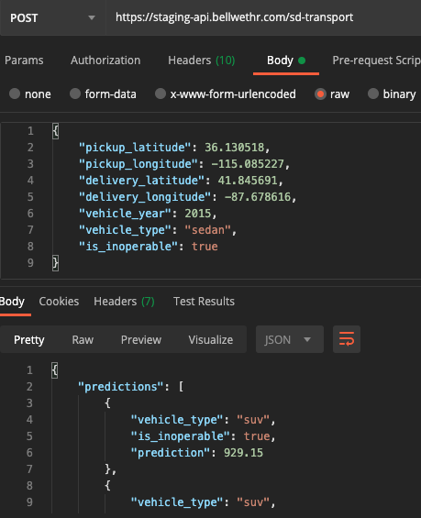
Our Production Methodology: Using API Technology to Get Data to Platforms
Using a technology called Cortex, we can run a model on any computer because it is maintained in the cloud (via AWS)
We have achieved fast results: a 1.1 second response time, 3x faster than previous response

Slide 9
Business Recommendations for the Kansas City Freight Industry
There is significant different between the top shipped items and others. Focusing marketing here could increase sales success.
There is a narrow range of geographies that are popular. Shipping in the MO, NE, and KS areas as drop-offs and pickups are popular; focus on markets here with premiums on sales.
Price ranges are narrow, many 0 dollar trips? This is confusing for a business to be offering such.

Slide 10
A Summary of Today’s Presentation & Future Directions of the API Work
Stack methods. Regression is imperfect and that’s ok, but pricing is complex.
Dig for insights into rules. We want to be agnostic about our features. Pre-determination is detrimental to the process
Focus on vehicle types. There’s clearly a preference for vehicles shipped. How can this help development of platforms?
Additional: Focus on geographies. We found local trips are more common than cross-country trips

Slide 11
Thank You! & Space for Questions
z

Slide 12
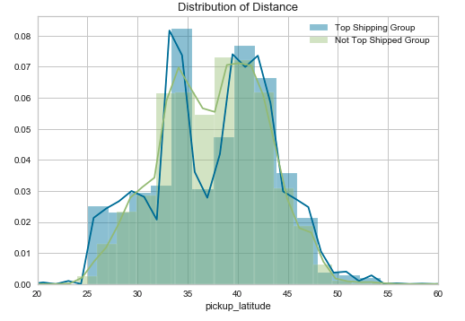
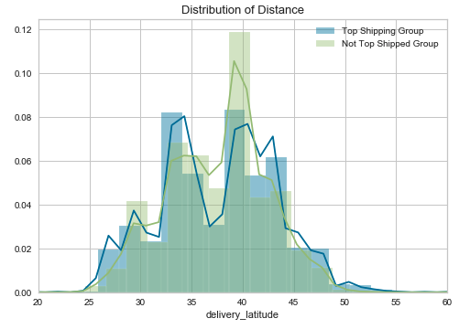
Appendix: Additional Work & Insights
z

Slide 13
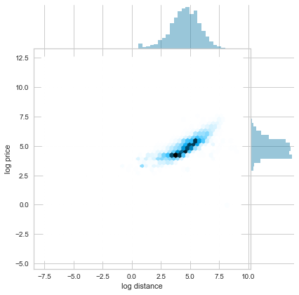
Additional Work: Expand the Factors
z

